Slide 1
the classifications of models used in thyroid disease are based on information from UCI machine learning repositories

Slide 2
CONTENT
Abstract
Introduction
Existing system
Disadvantages
Problem statement
Proposed system
Advantages
System requirement specifications
1. S/W & H/W
2. Functional & Non-Functional
SYSTEM DESIGN-ARCHITECTURE
ALGORITHM
.MODULES
DATA FLOW DIAGRAM/UML DIAGRAMS
Conclusion

Slide 3
ABSTRACT
Medical research is based on a complex axiom, and the major cause of medical diagnosis and prediction development is thyroid condition. One of the major organs in our body is the thyroid gland. The release of thyroid hormones is in charge of controlling metabolism. The two most common thyroid conditions that affect thyroid hormone production for regulation of body metabolism are hyperthyroidism and hypothyroidism. In order to research and classify thyroid disease on the basis of data from hospital datasets, machine learning is essential to the disease prediction process. To tackle dynamic learning problems like medical diagnosis and prediction tasks, a suitable knowledge base must be ensured, created, and used as a hybrid model. The detection and inhibition of thyroid are accomplished using fundamental machine learning techniques. The SVM is used to estimate the likelihood of a thyroid patient with reasonable accuracy. Our system must make recommendations if the patient is at danger for thyroid disease, including home remedies, safety measures, and medicine.

Slide 4
INTRODUCTION
Healthcare employs sophisticated machine biology. For the purpose of predicting medical diseases, data collection was necessary. Various intelligent prediction algorithms are employed to detect diseases in their early stages. The medical information system is proficient with data sets, however there are no intelligent tools accessible for rapid disease diagnosis. Ultimately, while developing a prediction model, machine learning algorithms play a crucial role in resolving challenging non-linear situations. Any illness prediction model needs to be able to choose features from the many data sets that can be utilised to describe a healthy patient in as much detail as possible. Otherwise, misclassification can lead to an excellent patient getting the wrong kind of care. The biggest cardinal number is also the reality of predicting any ailment linked to thyroid disease.

Slide 5
EXISTING SYSTEM
Thyroid dysfunction is a crucial factor in the development of medical diagnoses and estimates, which is a difficult axiom of medical research. The hormones secreted by the thyroid are responsible for controlling metabolism. One of the two thyroid conditions that are frequently present releases thyroid hormones to regulate body metabolism: hyperthyroidism and hypothyroidism. Data c leaning techniques have been utilised to create data that is basic enough to perform analytics to show the possibility that patients have thyroid.

Slide 6
DISADVANTAGES
Medical research is based on a complex axiom, and the major cause of medical diagnosis and prediction development is thyroid condition.
Machine learning is essential for studying and classifying thyroid illness based on data from hospital datasets and for the disease prediction process.

Slide 7
PROBLEM STATEMENT
Ultimately, while developing a prediction model, machine learning algorithms play a crucial role in resolving challenging non-linear situations. Any illness prediction models require features that may be chosen from the various data sources and utilised to describe a healthy patient as precisely as feasible.

Slide 8
PROPOSED SYSTEM
Machine learning is crucial to the prediction process, and paper research as well as the classifications of thyroid illness models are based on data from UCI machine learning archives. In order to address complicated learning difficulties, such as medical diagnostics and statistical tasks, a good knowledge base that can be centred and used as a hybrid paradigm must be kept. We also suggested other methods for thyroid detection and machine learning. K-NN, Decision Trees, Vector Support Machine, and machine learning algorithms were utilised to determine the estimated likelihood that a patient had thyroid disease.

Slide 9
ADVANTAGES
prevents radioactive iodine and anti-thyroid medication's long-term hazards.
immediately provides histological tissue and allows for childbearing

Slide 10
SYSTEM REQUIREMENT SPECIFICATIONS
Hardware Requirements
1)Operating System : Windows Only
2)Processor : i5 and above
3)Ram : 4gb and above
4)Hard Disk : 50 GB
Software Requirement
1)Visual Studio Community Version
2)Nodejs ( Version 12.3.1)
3)Python IDEL ( Python 3.7 )

Slide 11
FUNCTIONAL REQUIREMENTS
Functional requirements are represented or stated in the form of input to be given to the system, the operation performed and the output expected. System should collect the data from any resources. All the collected data should be processed for proper use, some analysis should be done for understanding the data properly.
Upload Thyroid Dataset
Data Preprocessing
Feature Extraction
Build SVM & PCA with SVM Classifiers
Upload Test Data
Predict Diseases With Suggestions

Slide 12
NON-FUNCTIONAL REQUIREMENTS
Usability
Usability is the main non-functional requirement for the “Prediction And Providing Medication For Thyroid Disease Using Machine Learning Technique”.The UI should be simple enough for everyone to understand and get the relevant information without any special training. Different languages can be provided based on the requirements.
Accuracy
Accuracy is another important non-functional requirement for the “Prediction And Providing Medication For Thyroid Disease Using Machine Learning Technique”. The dataset is used to Train and Test Model in python .Prediction should be correct, consistent, and reliable.
Availability
The System should be available for the duration when the user operates and must be recovered within an hour or less if it fails. The system should respond to the requests within two seconds or less.
Maintainability
The software should be easily maintainable and adding new features and making changes to the software must be as simple as possible. In addition to this, the software must also be portable.

Slide 13
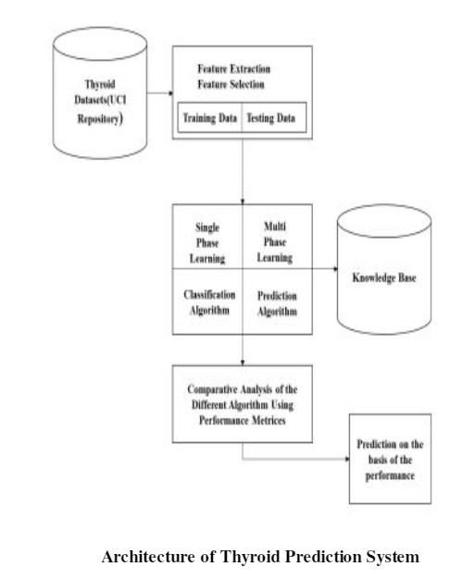
SYSTEM DESIGN ARCHITECTURE

Slide 14
ALGORITHMS
SVM: Support Vector Machine or SVM is one of the most popular Supervised Learning algorithms, which is used for Classification as well as Regression problems.
PCA with SVM: using PCA to significantly reduce dimensionality before running SVM, this can impair SVM
Random Forest: Random forest is a Supervised Machine Learning Algorithm that is used widely in Classification and Regression problems.
Decision Tree:A decision tree is a graph that uses a branching method to illustrate every possible output for a specific input.
Catboost: CatBoost is an algorithm for gradient boosting on decision trees.
adaboost with PCA. An AdaBoost classifier is a meta-estimator that begins by fitting a classifier on the original dataset and then fits additional copies of the classifier on the same dataset but where the weights of incorrectly classified instances are adjusted such that subsequent classifiers focus more on difficult cases.

Slide 15
MODULES
Data exploration: using this module we will load data into system
Processing: Using the module we will read data for processing
Splitting data into train & test: using this module data will be divided into train & test
Model generation: SVM and PCA with SVM, Random Forest, Decision Tree, Catboost, adaboost with PCA.
User signup & login: Using this module will get registration and login
User input: Using this module will give input for prediction
Prediction: final predicted displayed

Slide 16
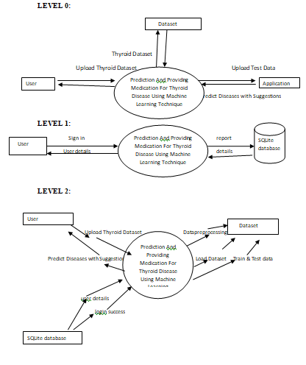
DATAFLOW DIAGRAM

Slide 17
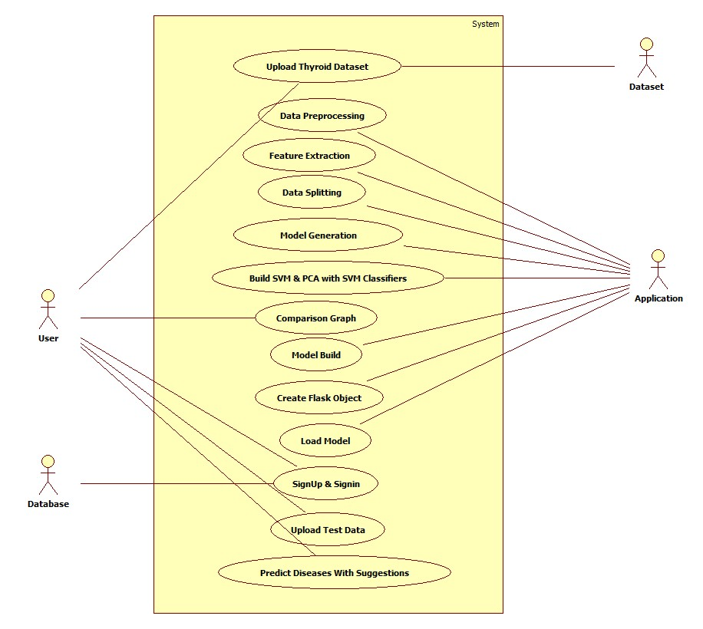
USECASE DIAGRAM

Slide 18
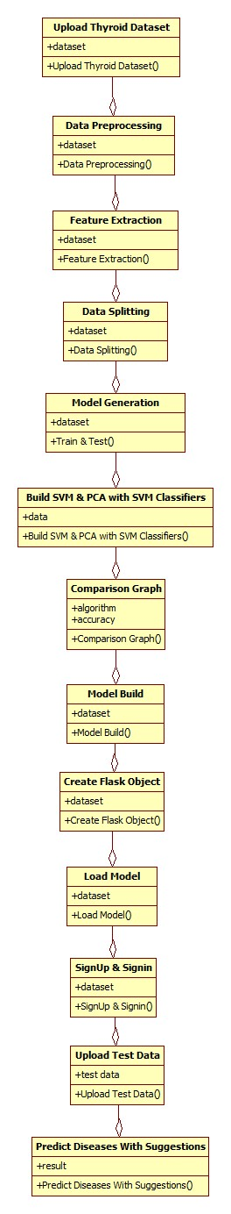
CLASS DIAGRAM

Slide 19
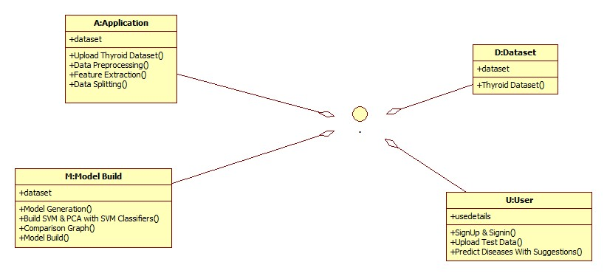
OBJECT DIAGRAM

Slide 20
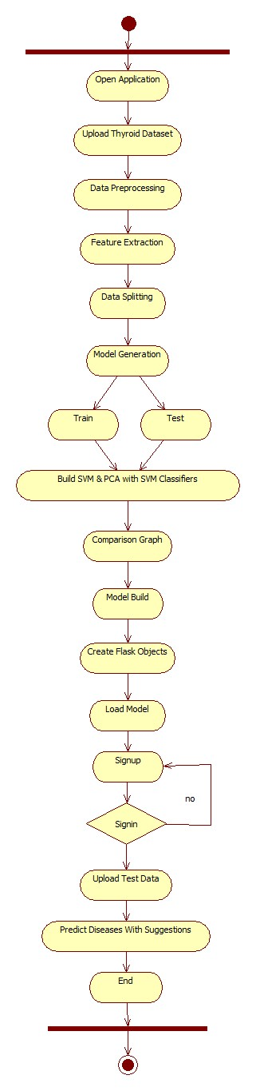
STATE DIAGRAM

Slide 21
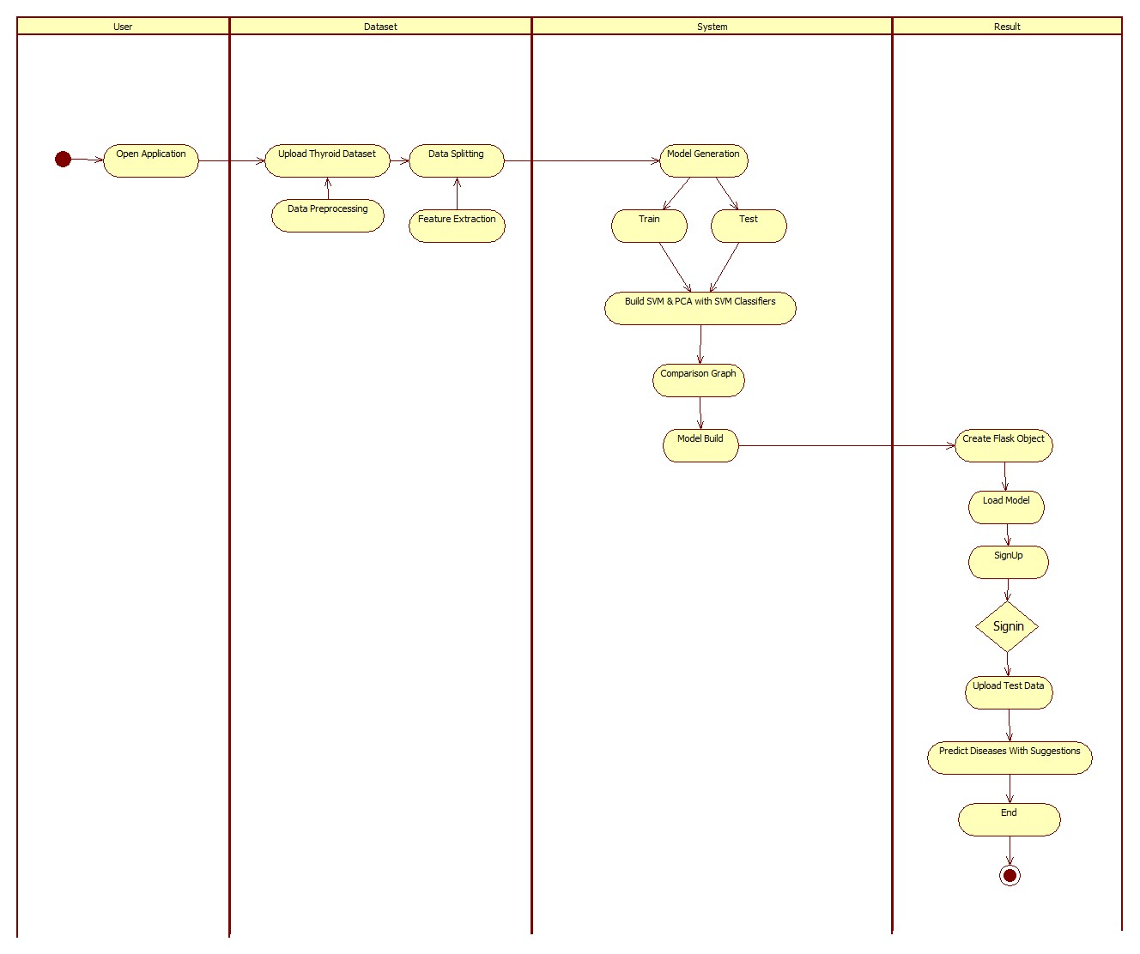
ACTIVITY DIAGRAM

Slide 22
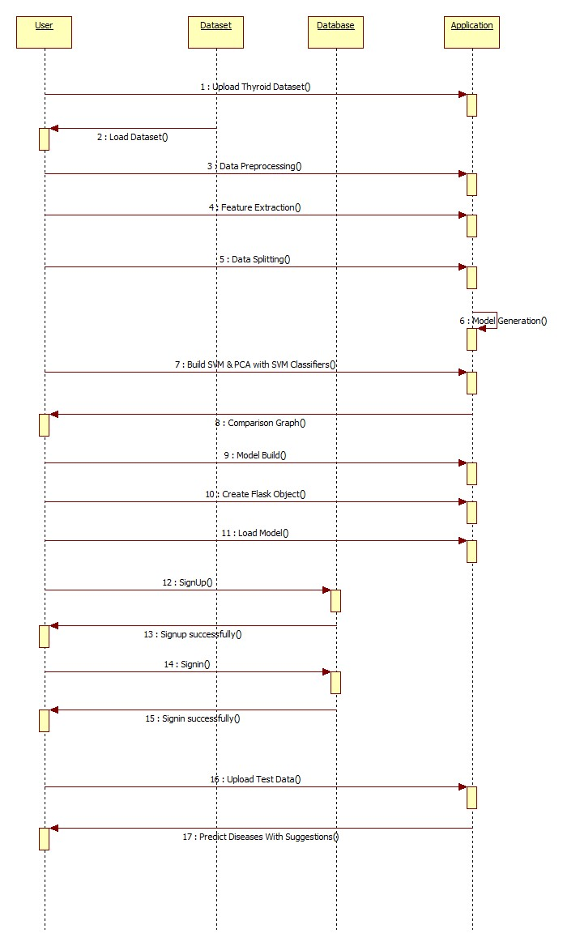
SEQUENCE DIAGRAM

Slide 23
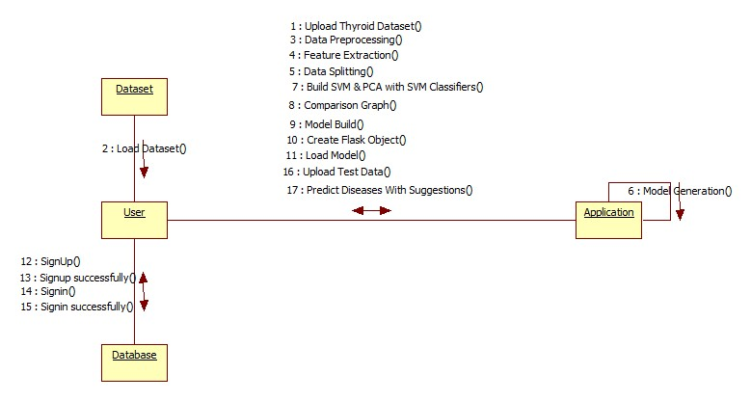
COLLABORATION DIAGRAM

Slide 24
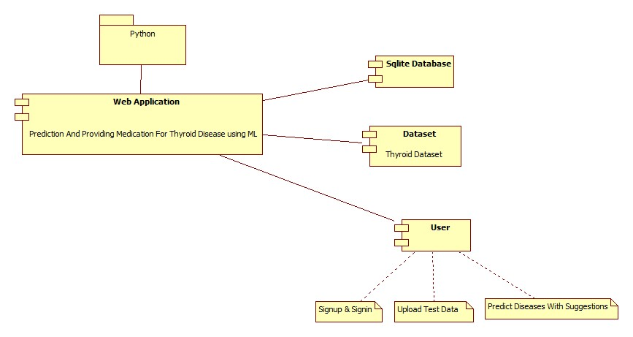
COMPONENT DIAGRAM

Slide 25
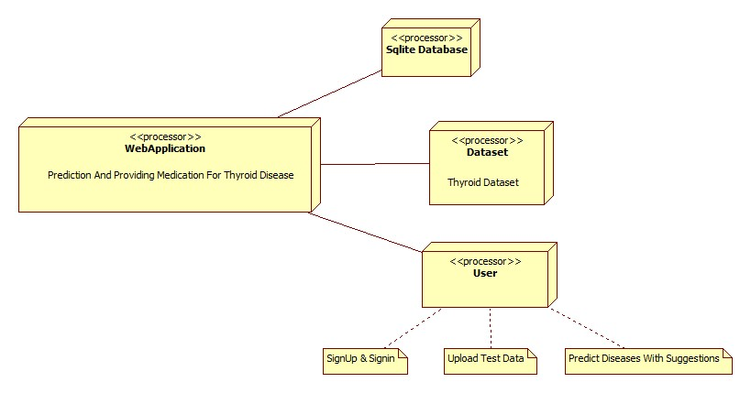
DEPLOYMENT DIAGRAM

Slide 26
CONCLUSION
The research effort examines the novel machine learning techniques that can be used to diagnose thyroid disorders. Recent years have seen the development and application of several accessible analyses for the accurate and expert diagnosis of thyroid illness. According to a study, both articles' precision was demonstrated by distinct technologies.

Slide 27
EXTENSION
1) In this paper the author had applied the SVM (accuracy is 90) and PCA with SVM (accuracy is 96).
2) So as an extension we will apply some other algorithms like Random Forest, Decision Tree, Catboost, adaboost with PCA.
3) To further more enhance SVM accuracy we will apply gridsearchcv to it.
4) For this project we will implement Front end using Flask Framework as an extension.
5) We will provide user authentication using sqlite3 databaseBase paper link - https://turcomat.org/index.php/turkbilmat/article/view/10292

